Slide 1
DATA ANALYTICS & VISUALIZATION
Enterprise Business
Intelligence Dashboard
Batch – 05 :
Sesank Reddy – 2420030161
Sai Sri Harsha – 2420030190
Sathwik - 2420030048
Anajan Reddy - 2420030750
Department of Computer Science and Engineering
KLH Hyderabad
LIVE PROJECT OUTPUT
BI Dashboard
bi-dashboard-05-dav-project.vercel.app
Review focus: show the implemented system, prove that it runs, and explain the analytical output.

Slide 2
Scope & Project Goal
The review is evaluated on implementation, execution/functionality, and results obtained with analysis.
EVALUATION 1
EVALUATION 2
EVALUATION 3
Project Implementation
Execution & Functionality
Results & Analysis
End-to-end BI dashboard artifact implemented as a web application
Data-to-visualization flow designed for organizational performance analysis
Reusable KPI, filter, comparison and reporting structure
Deployed project output available for live demonstration
Dashboard loads as a working interface
Interactive views are organized around KPIs and charts
Filters and analytical navigation are part of the workflow
User can move from summary to detailed analysis
Visual outputs convert raw records into decision-ready summaries
Trend and comparison views reveal changes across dimensions
Results are interpreted through KPI context, not chart appearance alone
Performance and quality gaps are identified for next iteration
Core project question
How can organizational data be transformed into an interactive, reliable and interpretable BI dashboard for practical decision support?

Slide 3
Project Implementation – End-to-End Architecture
The implementation separates data handling, analytics logic, visualization and user interaction so each layer can be tested independently.
DATA SOURCES
PREPROCESSING
ANALYTICAL LAYER
BI DASHBOARD
DECISION SUPPORT
Structured records
CSV / DB / APIs
Validation • cleaning
transformations
Dimensions • measures
KPI logic
KPI cards • charts
filters • detail views
Compare • diagnose
report • act
Implementation principle
Business definitions are centralized: the same KPI should return the same value across cards, charts, tables and exports for the same filter context.
Review-2 evidence: architecture demonstrates how the project moves from implementation to an observable dashboard output.

Slide 4
Project Implementation – Major Modules
The dashboard is presented as a set of focused modules, each responsible for one part of the analytics workflow.
Data Ingestion
Data Validation
1
Load structured records and retain source context
2
Check completeness, validity, duplicates and consistency
KPI Engine
Visualization Layer
3
Calculate growth, achievement and performance measures
4
Convert measures into charts, tables and trend views
Interaction Layer
Reporting Layer
5
Filters, selections, comparisons and drill-down
6
Summarize the current analytical state for review/export
Implementation outcome: modularity makes the system easier to validate, debug and extend with forecasting or anomaly analysis later.

Slide 5
Implementation Details – Tools, Technologies & Engineering Practices
Technology choices are presented at the role level so the review focuses on what each technology contributes to the dashboard.
WEB APPLICATION
DATA & LOGIC
VISUAL ANALYTICS
DEPLOYMENT
Frontend UI
Responsive layout
Component-based structure
Data ingestion
Cleaning & validation
KPI/business rules
Interactive charts
Tables & comparisons
Trend representations
Cloud deployment
HTTPS endpoint
Live project URL
Engineering practices emphasized in Review-2
Centralize KPI definitions to avoid inconsistent calculations
Keep large-data processing off the browser where possible
Use loading, empty-state and error-state handling
Measure web performance before making optimization claims
Deployment endpoint
https://bi-dashboard-05-dav-project.vercel.app/

Slide 6
Execution Output – BI Dashboard Interface
Editable recreation of the dashboard output for the review presentation. The live deployment can be opened during the demo.
BI
DASHBOARD
Organizational Performance Overview
2026
ALL DEPARTMENTS
TOTAL REVENUE
TARGET ACHIEVEMENT
PERFORMANCE SCORE
DATA COMPLETENESS
₹ —
— %
—
— %
Overview
Current view
Filter aware
Normalized
Validated
Performance
Performance Trend
Department Comparison
Departments
Trend is interpreted within the active filter and time context.
Sales
Employees
Engineering
Analytics
Finance
HR
Reports
Q1
Q2
Q3
Q4
Q5
Q6
Q7
Insight workflow: KPI → filter/compare → drill down → explain the change → report

Slide 7
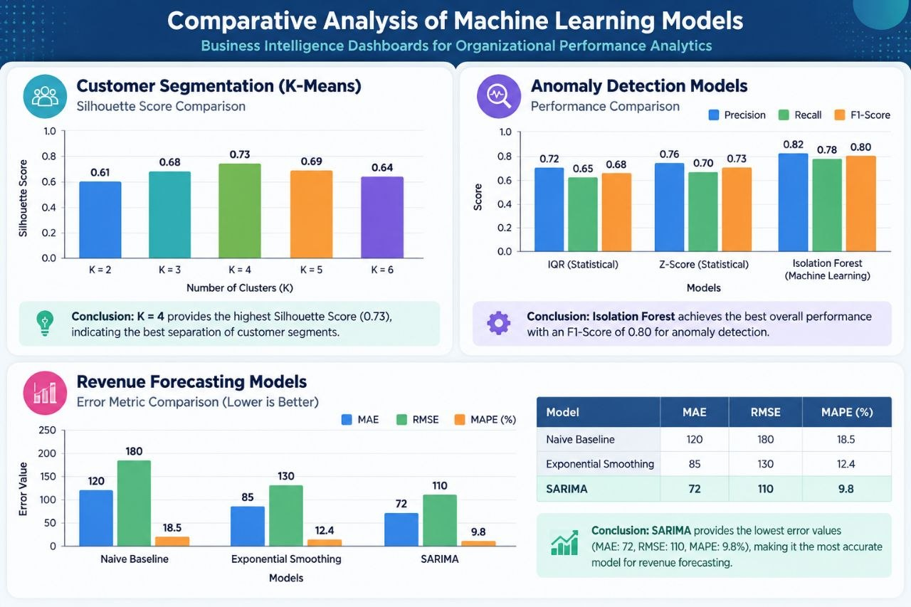
Comparative Analysis
Output area
Observed result
Analysis / value
Publication integrity note: no fabricated accuracy, latency or user-study values are shown here. Those measurements should be added after controlled testing.

Slide 8
Results — Observed Dashboard Performance Metrics
Values transcribed from the current project output captures supplied with Review-2.
Observed metric | Result | Dashboard evidence
Total revenue | ₹23,31,50,101.47 | Executive / Sales
Orders | 12,500 | Sales
Average order value | ₹18,652.01 | Sales
Quota achievement | 94% | Sales
Net profit | ₹10,07,11,852.06 | Executive / Finance
Net profit margin | 43.2% | Executive / Finance
Operating expense | ₹7,82,28,509.72 | Finance
Net cash flow | ₹6,11,46,190.12 | Finance
Revenue growth | +100.4% | Executive
Marketing ROI | 9726.7% | Business Insights
Interpretation: these are artifact-observable business results; they are not substituted for controlled ML accuracy or web-performance benchmarks.
DAV • Enterprise BI Research Upgrade
22

Slide 9
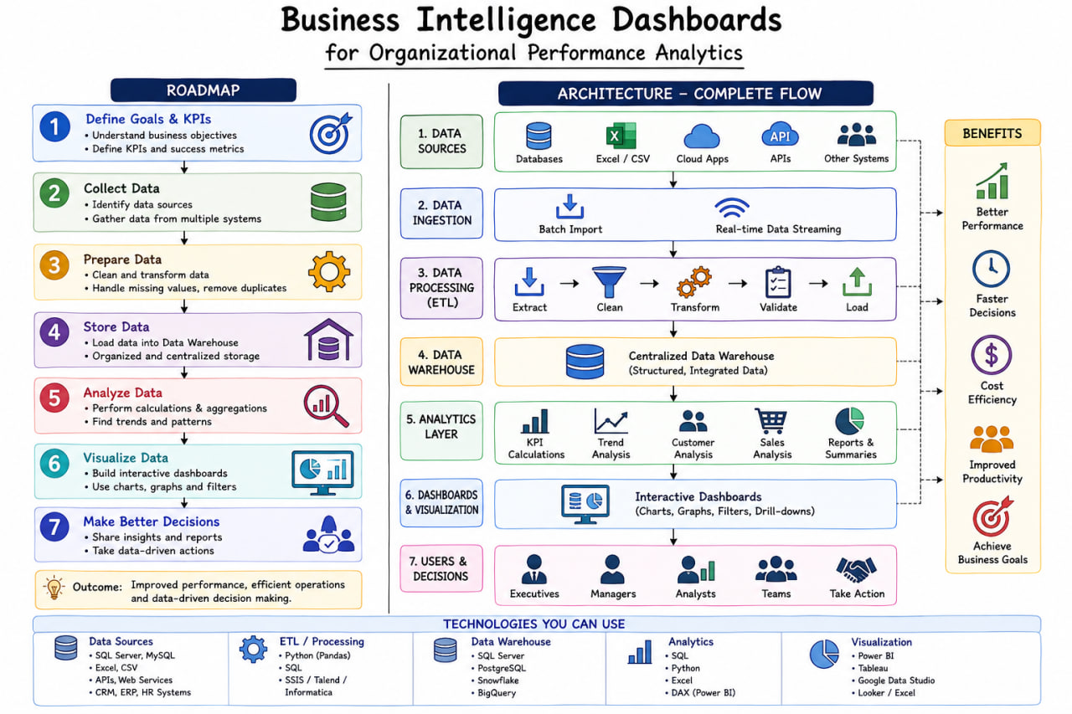
Proposed System Architecture
The new HEWDF layer is explicitly located after analytics generation and before recommendation/decision output.
DAV • Enterprise BI Research Upgrade
19

Slide 10
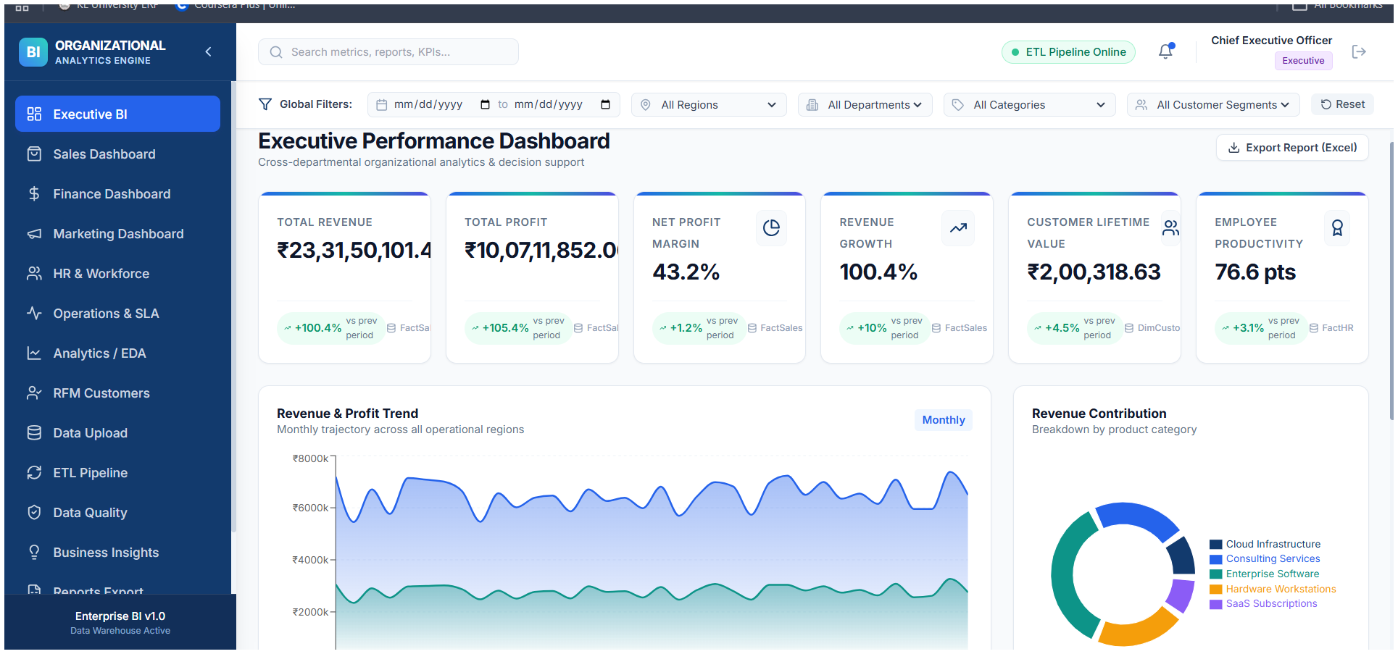
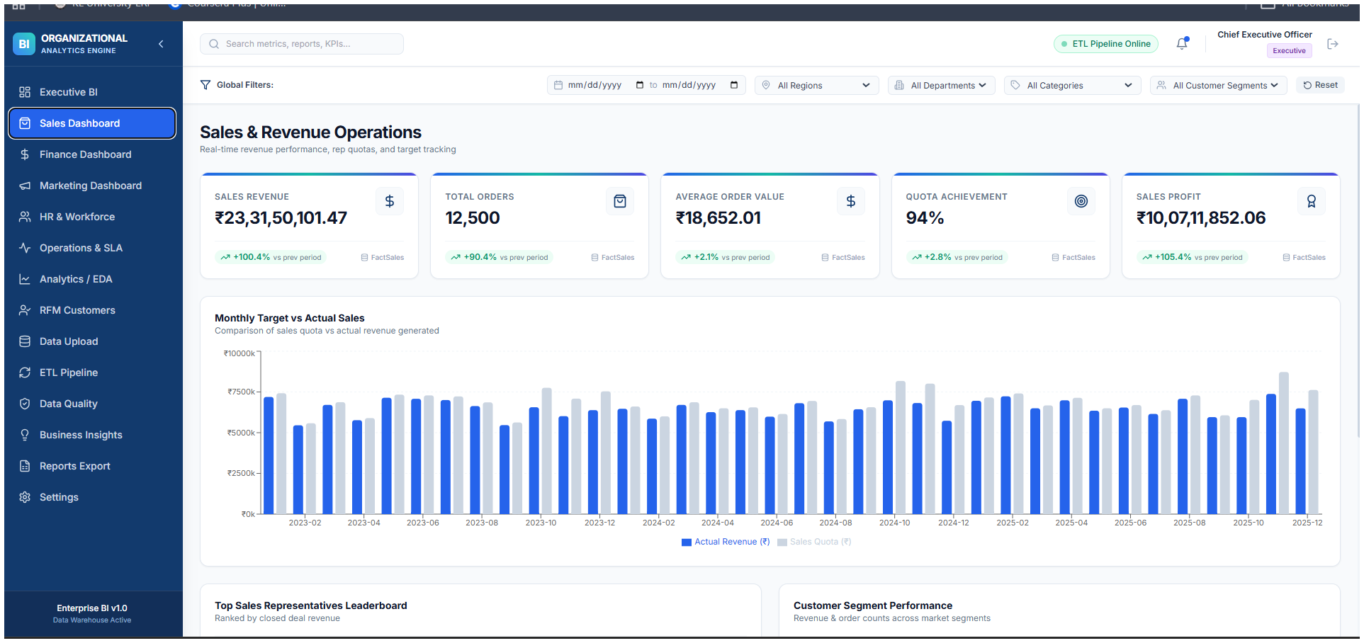
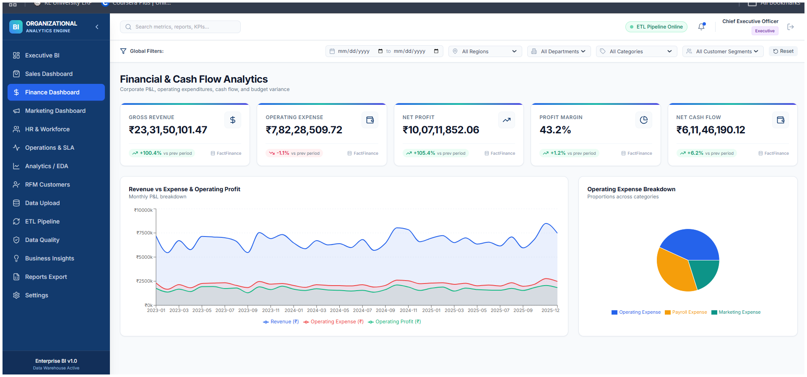
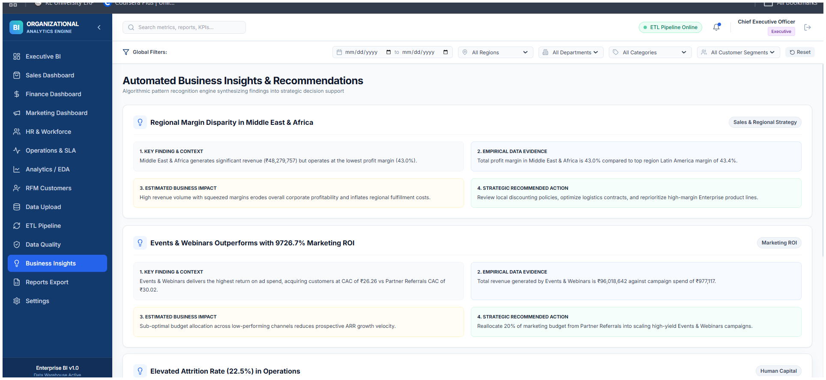
ACTUAL PROJECT OUTPUT
Live Dashboard Evidence
Four captured screens from the deployed BI dashboard show implementation, execution, and analytical outputs.
Executive BI
Sales & Revenue
Finance & Cash Flow
Business Insights

Slide 11
DASHBOARD SCREEN 01
Executive BI — Organizational Performance
High-level KPI monitoring and cross-departmental decision support.
KPI overview
Revenue, profit, margin, growth, customer value and employee productivity are visible in one executive view.
Global filtering
Date, region, department, category and customer-segment filters provide a shared analytical context.
Decision support
Revenue/profit trend and revenue contribution visuals support deeper analysis.
What to demonstrate
• Use during the live demo.
• Point to the KPI/visuals and explain the analytical purpose.
Captured Executive Performance Dashboard

Slide 12
DASHBOARD SCREEN 02
Sales & Revenue Operations
Revenue, orders, average order value and quota-achievement tracking.
Core outputs
Sales revenue ₹23,31,50,101.47 • 12,500 orders • AOV ₹18,652.01 • quota achievement 94%.
Comparison
Monthly actual revenue is compared against sales quota for target tracking.
Performance analysis
Leaderboard and customer-segment views support sales-team and market-segment analysis.
What to demonstrate
• Use during the live demo.
• Point to the KPI/visuals and explain the analytical purpose.
Captured Sales & Revenue Operations Dashboard

Slide 13
DASHBOARD SCREEN 03
Financial & Cash Flow Analytics
P&L, operating expenditure, profit margin and cash-flow visibility.
Financial KPIs
Gross revenue ₹23,31,50,101.47 • operating expense ₹7,82,28,509.72 • net profit ₹10,07,11,852.06.
Profitability
Profit margin is displayed at 43.2% alongside the trend view.
Cash flow
Net cash flow is shown as ₹6,11,46,190.12 with an operating-expense breakdown.
What to demonstrate
• Use during the live demo.
• Point to the KPI/visuals and explain the analytical purpose.
Captured Financial & Cash Flow Analytics Dashboard

Slide 14
DASHBOARD SCREEN 04
Automated Business Insights & Recommendations
Evidence-driven findings, contextual metrics, estimated impact and strategic actions.
Regional margin insight
Middle East & Africa: ₹48,279,757 revenue and 43.0% margin; compared with Latin America at 43.4%.
Marketing insight
Events & Webinars is shown with 9726.7% marketing ROI plus revenue, spend and CAC evidence.
Recommendation layer
Each insight is structured as finding/context → empirical evidence → estimated impact → recommended action.
What to demonstrate
• Use during the live demo.
• Point to the KPI/visuals and explain the analytical purpose.
Captured Automated Business Insights Dashboard

Slide 15
Execution & Functionality – Demonstration Flow
This is the sequence to follow during the live Review-2 demonstration.
1
Open
2
Inspect
3
Filter
Launch the deployed BI dashboard
Read KPIs and current dashboard state
Change time / organizational context
4
Compare
5
Drill Down
6
Report
Identify differences across units or periods
Move from summary to detailed records
Explain result and export/share the view
Live demo cue: keep the dashboard open on one screen and this slide on the presentation timeline so the evaluator can map each action to the function under review.

Slide 16
Execution & Functionality – What the Dashboard Delivers
Core functions are grouped by the analytical job they help the user perform.
MONITOR
FILTER
COMPARE
DIAGNOSE
COMMUNICATE
KPI cards
Current state
Trend indicators
Time period
Department / unit
Context reset
Period vs period
Unit vs unit
Target vs actual
Drill-down
Segment contribution
Supporting table
Summary view
Export / report
Decision context
Functionality validation logic
A valid filter must change every linked visual consistently. A valid KPI must match an independent calculation. A valid drill-down must preserve context. A valid report must reflect the active filter state.
Result: the dashboard is evaluated as a workflow, not as a collection of disconnected charts.

Slide 17
Results Obtained – Implemented Dashboard Output
Results are presented as observed analytical outputs rather than unsupported numerical claims.
Output area
Observed result
Analysis / value
KPI overview
Consolidated performance indicators in a single view
Reduces the need to assemble separate reports
Trend analysis
Time-based visualization of changing performance
Makes direction and turning points easier to inspect
Comparison
Cross-unit / cross-period comparison
Helps identify relative under- and over-performance
Interactive context
Filter-driven analytical views
Lets the user focus on the relevant population
Decision workflow
Summary → compare → drill down → report
Connects observation to explanation and communication
Publication integrity note: no fabricated accuracy, latency or user-study values are shown here. Those measurements should be added after controlled testing.

Slide 18
Results Analysis – Quality, Performance & Reliability
Review-2 should show not only what works, but how the implementation will be judged for quality.
Evaluation area
What is analyzed
Evidence to capture
Functional correctness
Filters, sorting, drill-down, export
Scenario tests + expected/actual comparison
Data integrity
Completeness, duplicates, reconciliation
Independent reference calculation
Web performance
LCP / INP / CLS + API latency
Controlled desktop + mobile runs
Usability
Task success, time, perceived ease
Representative users + SUS
Accessibility
Keyboard, focus, semantics, contrast
Automated + manual WCAG review
Security
Auth, access control, validation, data exposure
Endpoint and configuration tests
Analysis message: performance should be measured, not assumed. When a bottleneck is found, optimize data transfer, rendering and repeated calculations before adding more visual complexity.

Slide 19
Findings, Novelty & Research Upgrade
The Review-2 discussion should show that the team understands what is complete and what still needs engineering evidence.
CURRENT STRENGTHS
NEXT ENGINEERING STEPS
Unified BI interface
Interactive analytical flow
Clear KPI-to-analysis concept
Live deployment for demonstration
Instrument performance metrics
Validate every KPI against reference calculations
Add stronger drill-down / anomaly explanation
Complete accessibility and security testing
Collect user-study evidence if publication is required
IMPLEMENTED / DEMONSTRABLE
NEXT ITERATION
Why this matters for Review-2
A strong review explicitly connects implementation → observed output → analysis → improvement plan.

Slide 20
Conclusion – Research-Grade Takeaway
Close the review by showing the evaluator the complete story of the implemented artifact.
What we have demonstrated
3-part Review-2 story
A deployable BI dashboard that converts organizational data into visual analytics
A structured execution flow from KPI monitoring to comparison and detailed analysis
A clear framework for validating correctness, performance, usability and accessibility
A measurable roadmap for improving the artifact beyond the current review stage
IMPLEMENT
1
System built
EXECUTE
2
System works
ANALYZE
3
Results understood
Live demo
Open the deployed dashboard during Q&A / evaluator interaction.
Thank You
Questions & demonstration

Slide 21
Research Gap & Mandatory Novelty
The project is upgraded from a dashboard artifact to a testable hybrid decision-intelligence research artifact.
WHAT EXISTS IN THE CURRENT PROJECT
WHY THAT IS NOT ENOUGH
PROPOSED RESEARCH STEP
Executive BI
Sales & Revenue
Finance & Cash Flow
Marketing / HR / Operations
RFM & Analytics
Data Quality / ETL
Automated Business Insights
A dashboard alone is not novelty.
Multiple datasets alone are not novelty.
Individual ML models alone are not novelty.
The research needs a new computational step.
Hybrid Evidence-Weighted Decision Fusion (HEWDF)
Fuse predictive evidence + anomaly evidence + KPI deviation + cross-functional propagation + data/model reliability into an auditable decision-priority score.
DAV • Enterprise BI Research Upgrade
18

Slide 22
Detailed Methodology & Research Flow
The methodology separates observation, prediction, diagnosis, prioritization, and action.
1. Data ingestion
2. Data reliability
3. Analytical routing
CSV / DB / API records are validated and profiled.
Completeness, validity, duplicates, consistency and outlier indicators produce reliability evidence.
The system selects supported descriptive, predictive and anomaly analyses from data characteristics.
4. Cross-functional fusion
5. HEWDF
6. Traceable action
Linked KPIs across sales, finance, marketing, HR and operations form propagation evidence.
Evidence is normalized, reliability-adjusted and fused into a decision-priority score.
The system exposes the evidence chain and decision simulation rather than a black-box recommendation.
DAV • Enterprise BI Research Upgrade
20

Slide 23
Hybrid Evidence-Weighted Decision Fusion (HEWDF)
Proposed mathematical formulation for the novel step.
Hᵢ = Σₖ wᵢₖ Eᵢₖ
Eᵢ = [Pᵢ, Aᵢ, Dᵢ, Cᵢ, Qᵢ]
Pᵢ — Predictive
Aᵢ — Anomaly
Dᵢ — KPI deviation
Cᵢ — Propagation
Qᵢ — Reliability
Forecast residual / expected-value deviation.
Statistical or ML anomaly severity.
Distance from target/baseline.
Cross-functional dependency evidence.
Data/model reliability adjustment.
Weights are adaptive rather than fixed: evidence reliability and information content determine how strongly each evidence stream contributes.
DAV • Enterprise BI Research Upgrade
21

Slide 24
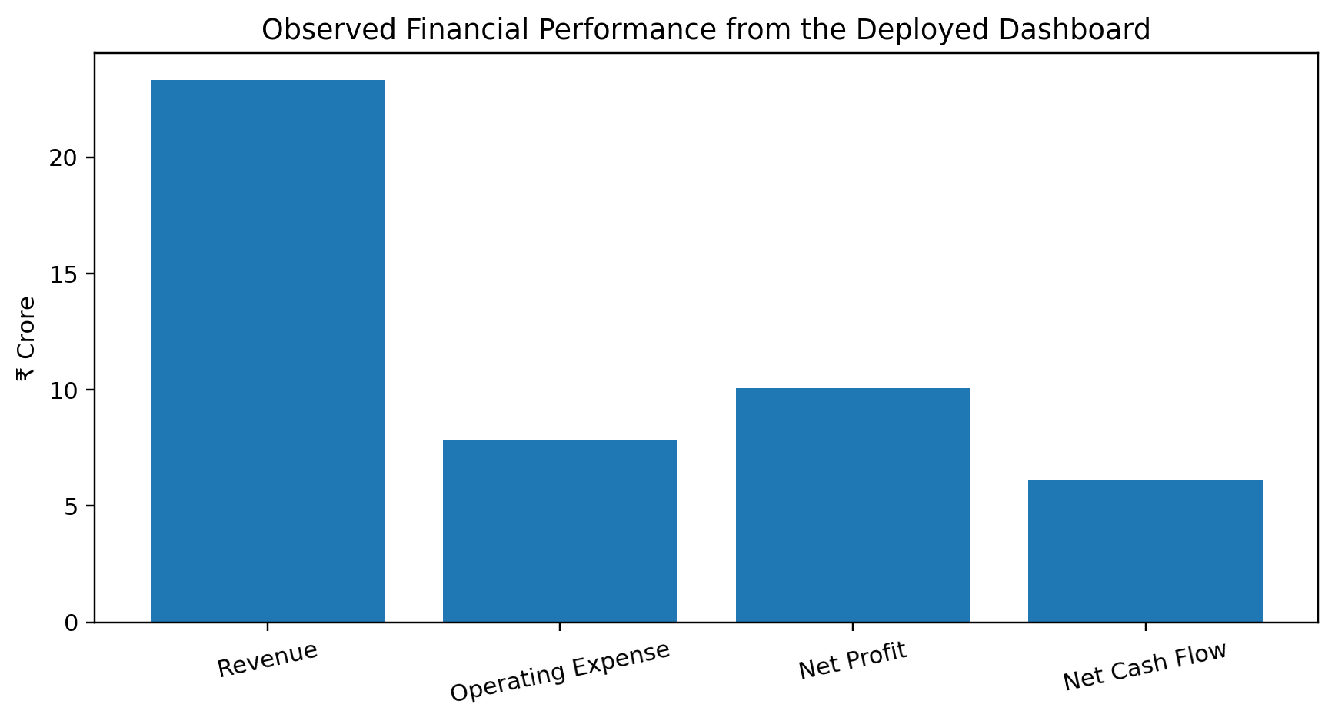
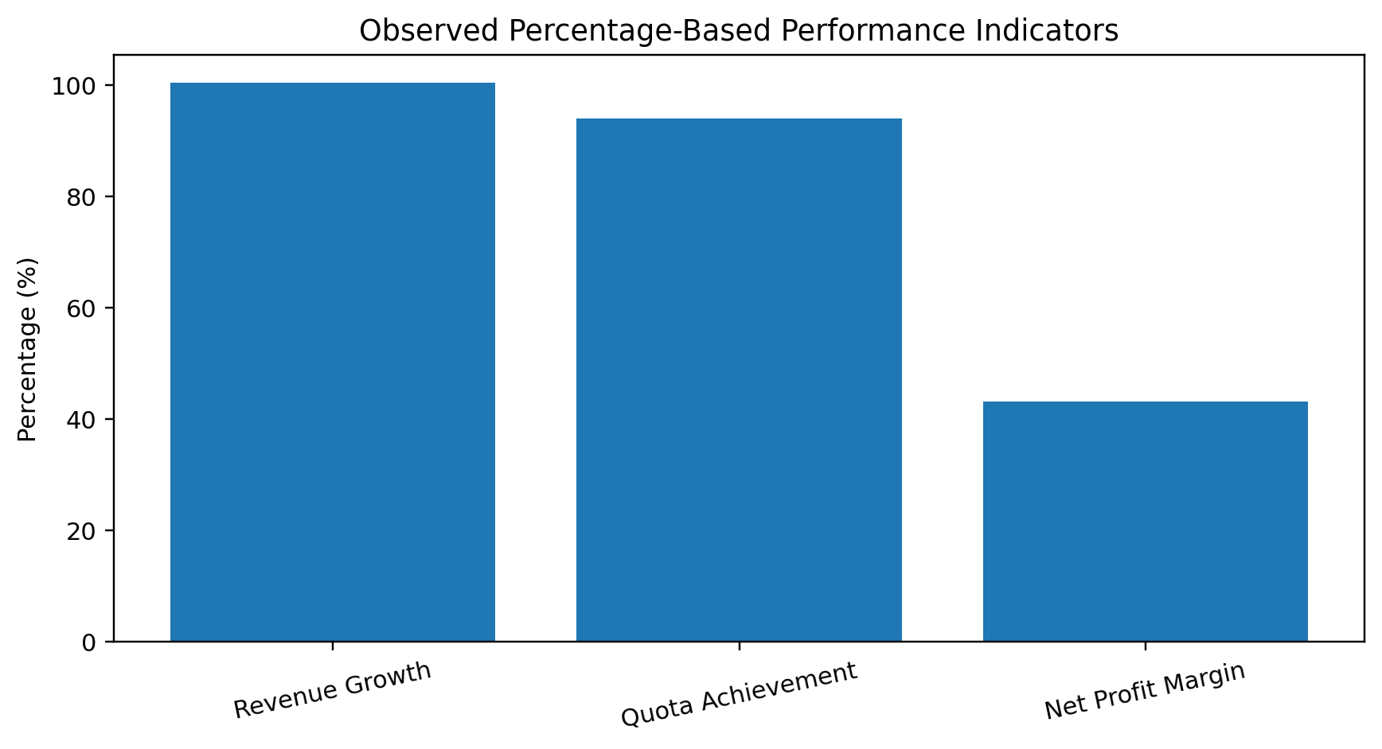
Results — Graphical Analysis
Graphs are computed from the observed dashboard outputs, not fabricated benchmark values.
Financial scale: revenue is the largest observed aggregate; net profit and cash flow provide profitability/liquidity context. Percentage view: growth and quota attainment are separated from margin to preserve interpretability.
DAV • Enterprise BI Research Upgrade
23

Slide 25
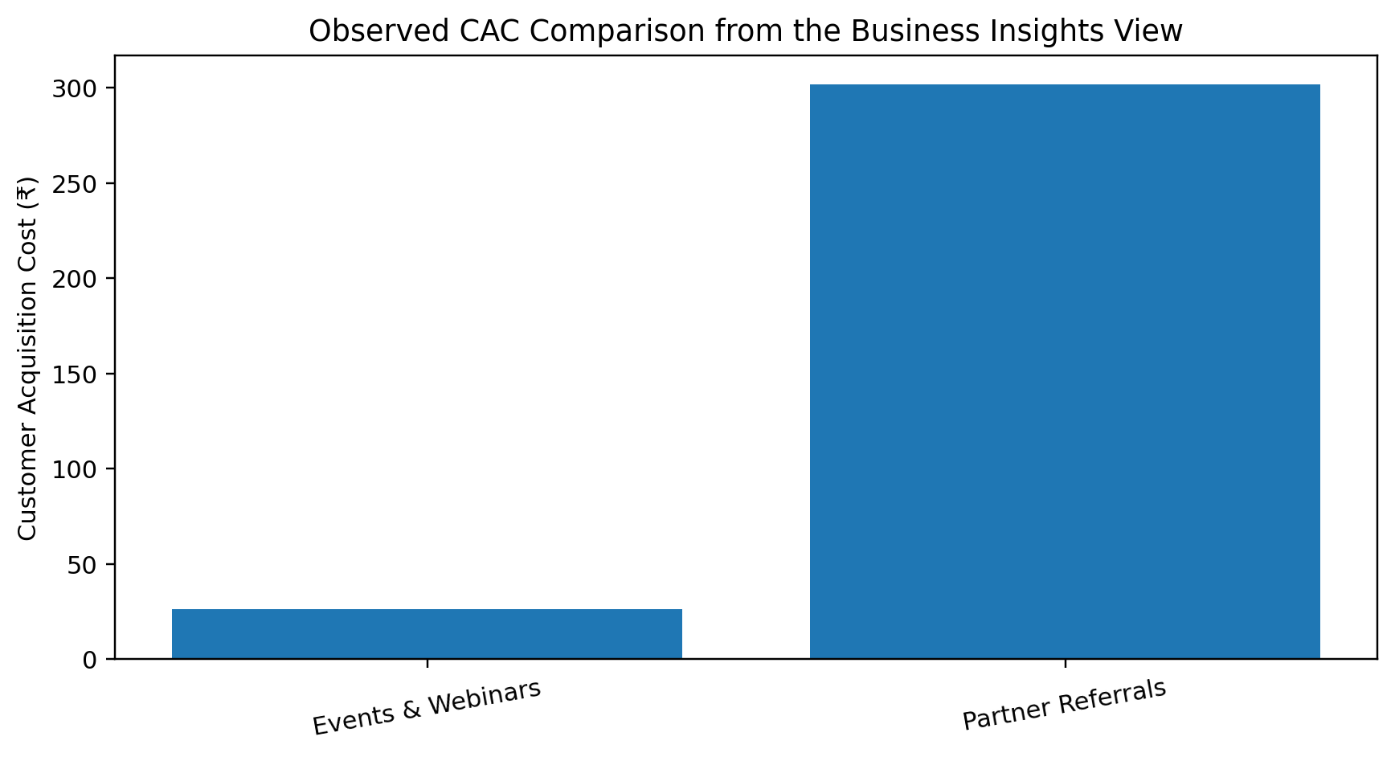
Results — Business Insight Evidence
The automated-insights screen links findings to evidence, impact and recommended action.
Interpretation: Events & Webinars is shown with ₹26.26 CAC versus ₹302.00 for Partner Referrals. The screenshot also demonstrates the existing four-part insight structure: context → evidence → impact → action.
DAV • Enterprise BI Research Upgrade
24

Slide 26
Frontend Output Screenshots — Research Evidence
The dashboard screenshots are part of the results section because the deployed frontend is the research artifact.
DAV • Enterprise BI Research Upgrade
25

Slide 27
Novelty Positioning — What Is Actually New?
The claim is framed as a proposed system-level contribution, not as an unsupported “first ever” statement.
Research direction | Established capability | Proposed project contribution
Adaptive BI | Adaptive algorithms / feedback | Reliability-adjusted evidence routing inside organizational KPI decision fusion
Cross-department BI | Cross-functional visualization | Cross-KPI propagation becomes an explicit decision-priority evidence stream
Hybrid ML–MCDM | Predictive + multi-criteria decision models | BI-specific fusion of prediction + anomaly + KPI + propagation + reliability evidence
Anomaly ensembles | Multiple anomaly models | Anomaly output becomes one component of a broader auditable decision score
Decision support | Dashboards / recommendations | Evidence lineage from source metric to fused priority and action
Important: a systematic literature review is still required before claiming that no equivalent combination exists in any prior paper.
DAV • Enterprise BI Research Upgrade
26

Slide 28
Experimental Evaluation & Ablation
The novelty must be demonstrated experimentally rather than asserted.
Experiment | Method | Primary performance metrics
B1 | Dashboard/rule only | Top-k priority precision; latency
B2 | Single predictive/anomaly model | MAE/RMSE/MAPE or Precision/Recall/F1
B3 | Fixed-weight fusion | Ranking quality; false-priority rate
B4 | Proposed HEWDF | Ranking quality; evidence completeness; latency
A1–A5 | Remove one HEWDF evidence stream | Change in ranking quality and false-priority rate
Publication rule: if no labeled ground truth or controlled decision study exists, do not invent accuracy values. Use a reproducible synthetic benchmark or expert-validated task set.
DAV • Enterprise BI Research Upgrade
27

Slide 29
Research Paper Mapping — Mandatory Evidence Package
Every included table, graph and screenshot is explained in the paper's Results section.
TABLES
GRAPHS
FRONTEND EVIDENCE
Table 5 — observed KPI results
Table 6 — internal consistency checks
Table 7 — evidence boundary
Table 8 — novelty positioning
Table 9 — hybrid-model evaluation plan
Fig. 5 — financial performance
Fig. 6 — percentage KPIs
Fig. 7 — CAC comparison
Each graph has a results interpretation paragraph.
Fig. 8 — Executive BI
Fig. 9 — Sales
Fig. 10 — Finance
Fig. 11 — Business Insights
Each screenshot is explained as research evidence.
DAV • Enterprise BI Research Upgrade
28

Slide 30
Final Research Story
The project now has a clear chain from implementation to measurable research contribution.
REAL DATA → ETL → BI → ML / ANOMALY → HEWDF → TRACEABLE DECISION PRIORITY → BUSINESS INSIGHT
IMPLEMENTATION
NOVELTY
EVIDENCE
Working enterprise BI artifact
Multiple functional dashboards
ETL / data quality / insights
Hybrid Evidence-Weighted Decision Fusion
Adaptive reliability weighting
Cross-functional propagation
Observed KPI results
Graphs
Frontend screenshots
Controlled evaluation + ablation
Next mandatory step: implement HEWDF in the live project, run the baseline/ablation experiments, and replace the current “not yet measured” cells with actual model-performance and web-performance results.
DAV • Enterprise BI • Research-grade revision
29

